Slide 1
Anomaly Detection using machine learning
Summer Workshop Industrial IoT 2022

Slide 2
Outline
Problem statement
What is deep learning?
Project week topics
Results
Conclusion

Slide 3
Problem statement
Deep Learning for anomaly detection
Detection of anomalies on the photos of material surfaces or of component assembly
Precisely analyse and control possible anomalies
Wide area of use (Industry, Medicine, …)
Fundamental theoretical knowledge in ML
Python as a programming language for the algorithm implementation

Slide 4
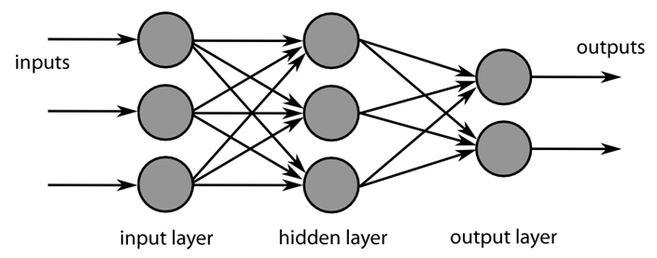
What is deep learning?
Subcategory of machine learning
Uses neuronal networks to analyse big datasets

Slide 5
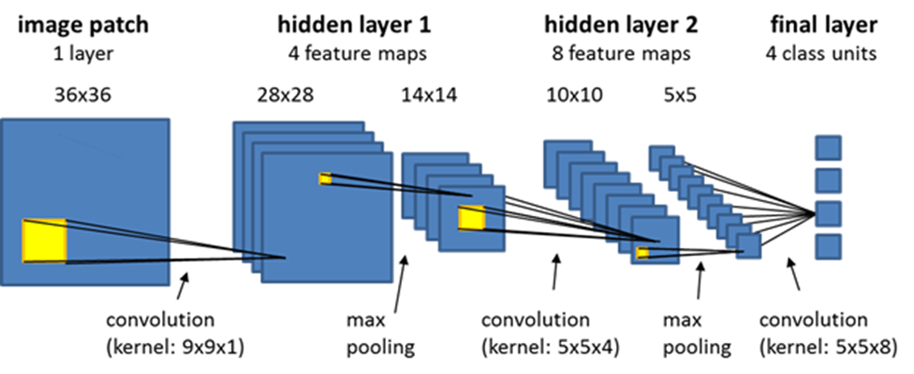
What is deep learning?
Convolutional Neural Network (CNN)
Convolution of picture with kernel -> features
Starting with simple (edges) to complicated (-> corners -> shapes -> abstract)
Applications: classification, segmentation, …

Slide 6
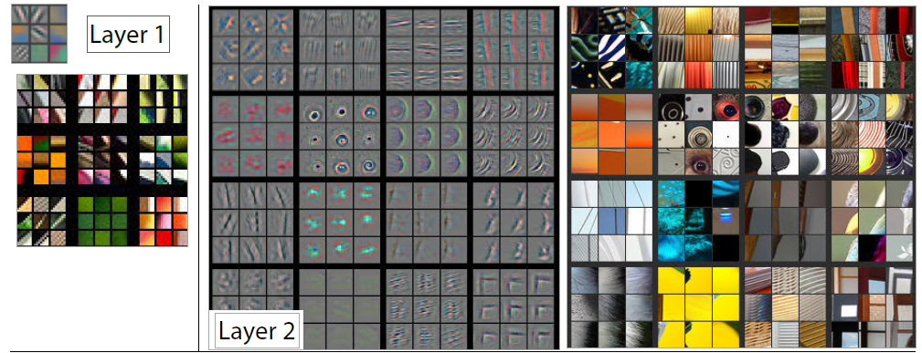
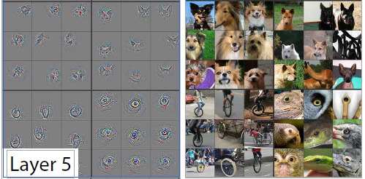
What is deep learning?

Slide 7
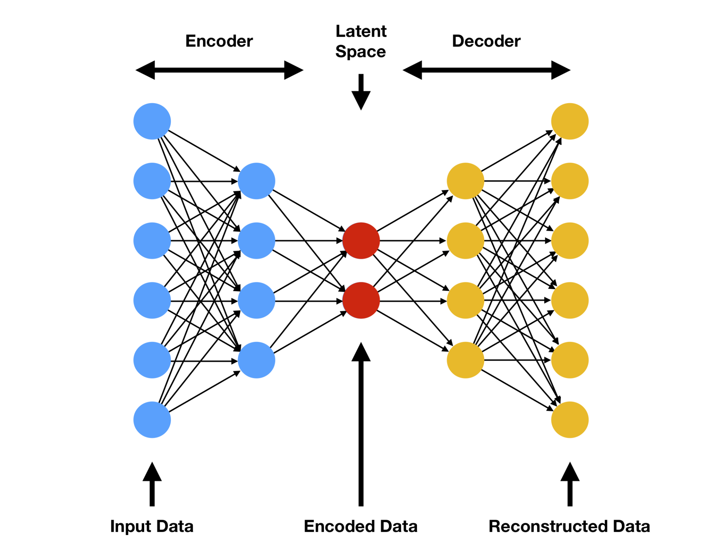
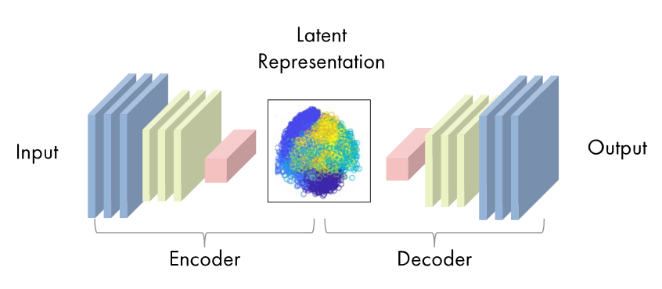
What is deep learning?
Autoencoder
Goal: reconstruct raw data
Encoding: extraction of features
Decoding: reconstruction from features
Evaluation: loss function
Applications: Image Compression, Feature Extraction,
Anomly Detection, …

Slide 8
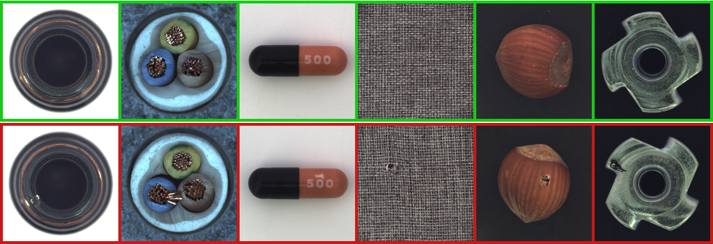
Project week topics - MVTEC Anomaly Detection Database

Slide 9
Project week topics - roadmap
1
2
3
4
learn
get to know
apply
analyze
Get theoretical input to learn the basics of machine learning, the underlying technology and algorithms.
Get an introduction to different machine learning algorithms, the differences in their approach and possible benefits over other models.
Test the different algorithms using a predefined dataset and export the results in a comparable format.
Analyze the results to discuss the viability of each algorithm and changes depending on specific cases.

Slide 10
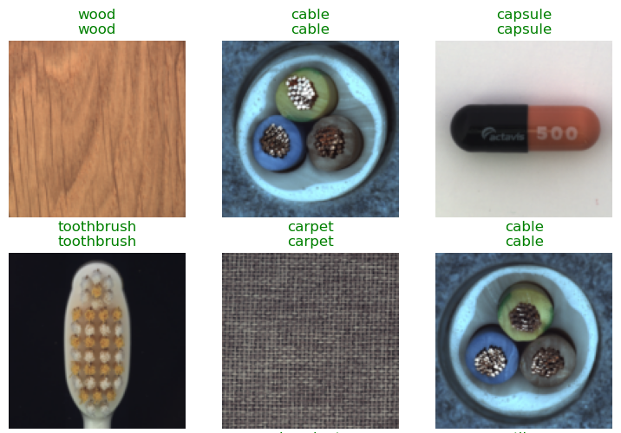
Project week topics - get to know
Different algorithms with increasing complexity:
Classificator algorithm
Anomaly detection algorithms
Resnet18
pixel to pixel comparison
Very Deep Convolutional Networks
feature loss
compare layers between original and reconstruction
Anomalib patchcore

Slide 11
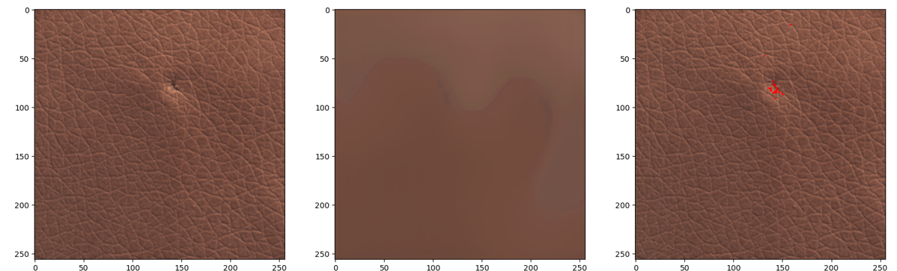
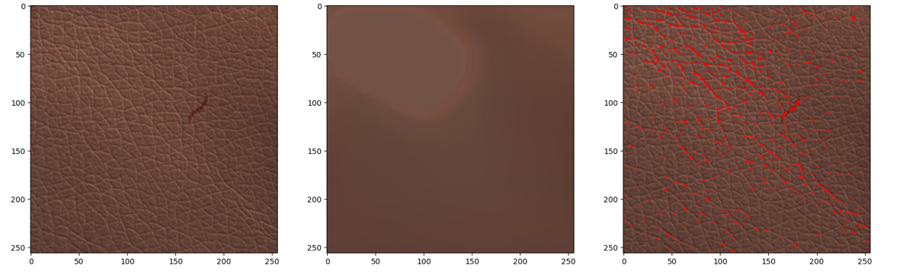
Not pre-trained Resnet18 - 10 Cycles
Material: Leather
Anomaly Type: Fold and Color
Model: Resnet18 Not Pretrained
Learning Time: 10 Cycles - 1 minute
Conclusion:
While the prediction after 10 cycles are terrible and only essentially show a flat color, it still can manage an identification if the heatmap cutoff values are properly tweaked and depending the anomaly type.
Identification Results by category:
- False Positives: Yes
- Missed Anomalies Yes
- Noise level on Mask Variable to High
Improvement Suggestions:
Heatmap needs to take the grain direction into account and filter for error width as to create a cleaner mask.
Input
Prediction
Anomalies
Fold
Color

Slide 12
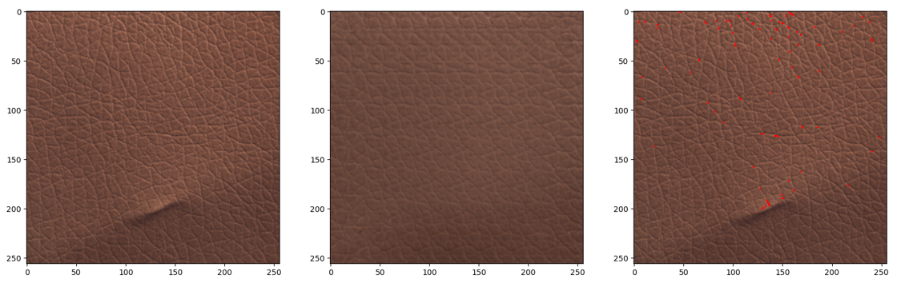
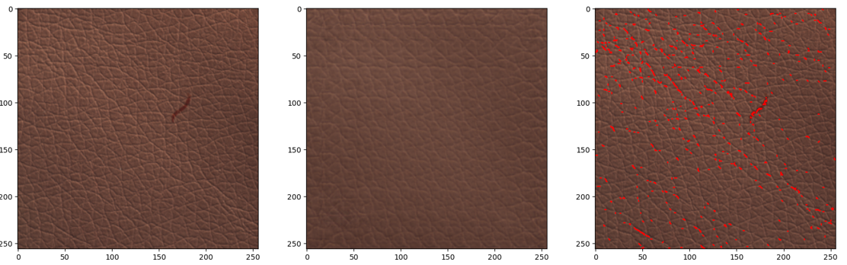
Not pre-trained Resnet18 - 400 Cycles
Material: Leather
Anomaly Type: Fold and Color
Model: Resnet18 Not Pretrained
Learning Time: 400 Cycles - 90 minutes
Conclusion:
After 400 cycles the prediction has reached the level of a pattern fill, yet little seems to have changed in regards to the capability of anomaly detection
Identification Results by category:
- False Positives: Yes
- Missed Anomalies Yes
- Noise level on Mask Variable to High
Improvement Suggestions:
Input
Prediction
Anomalies
Fold
Color

Slide 13
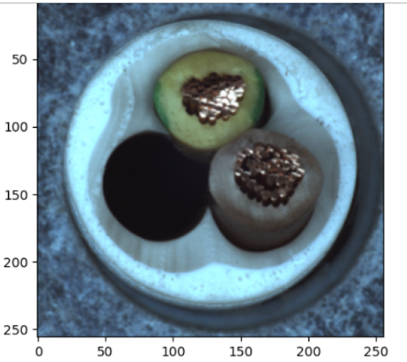
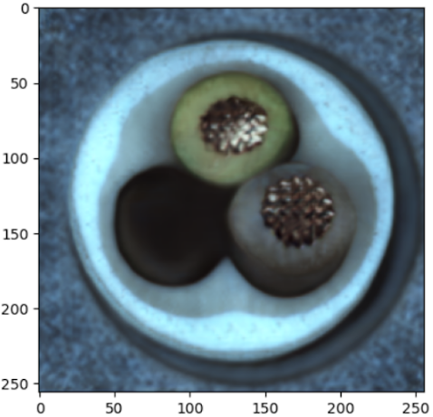
Not pre-trained Resnet18 - 400 Cycles
Material: Cable
Anomaly Type: Missing Part
Model: Resnet18 Not Pretrained
Learning Time: 400 Cycles - 90 minutes
Conclusion:
After 400 cycles the prediction via feature loss has reached a good level of reconstruction, yet it didnt detect the anomaly.
Identification Results by category:
- False Positives: No
- Missed Anomalies Yes
- Noise level on Mask Variable
Input
Reconstruction

Slide 14
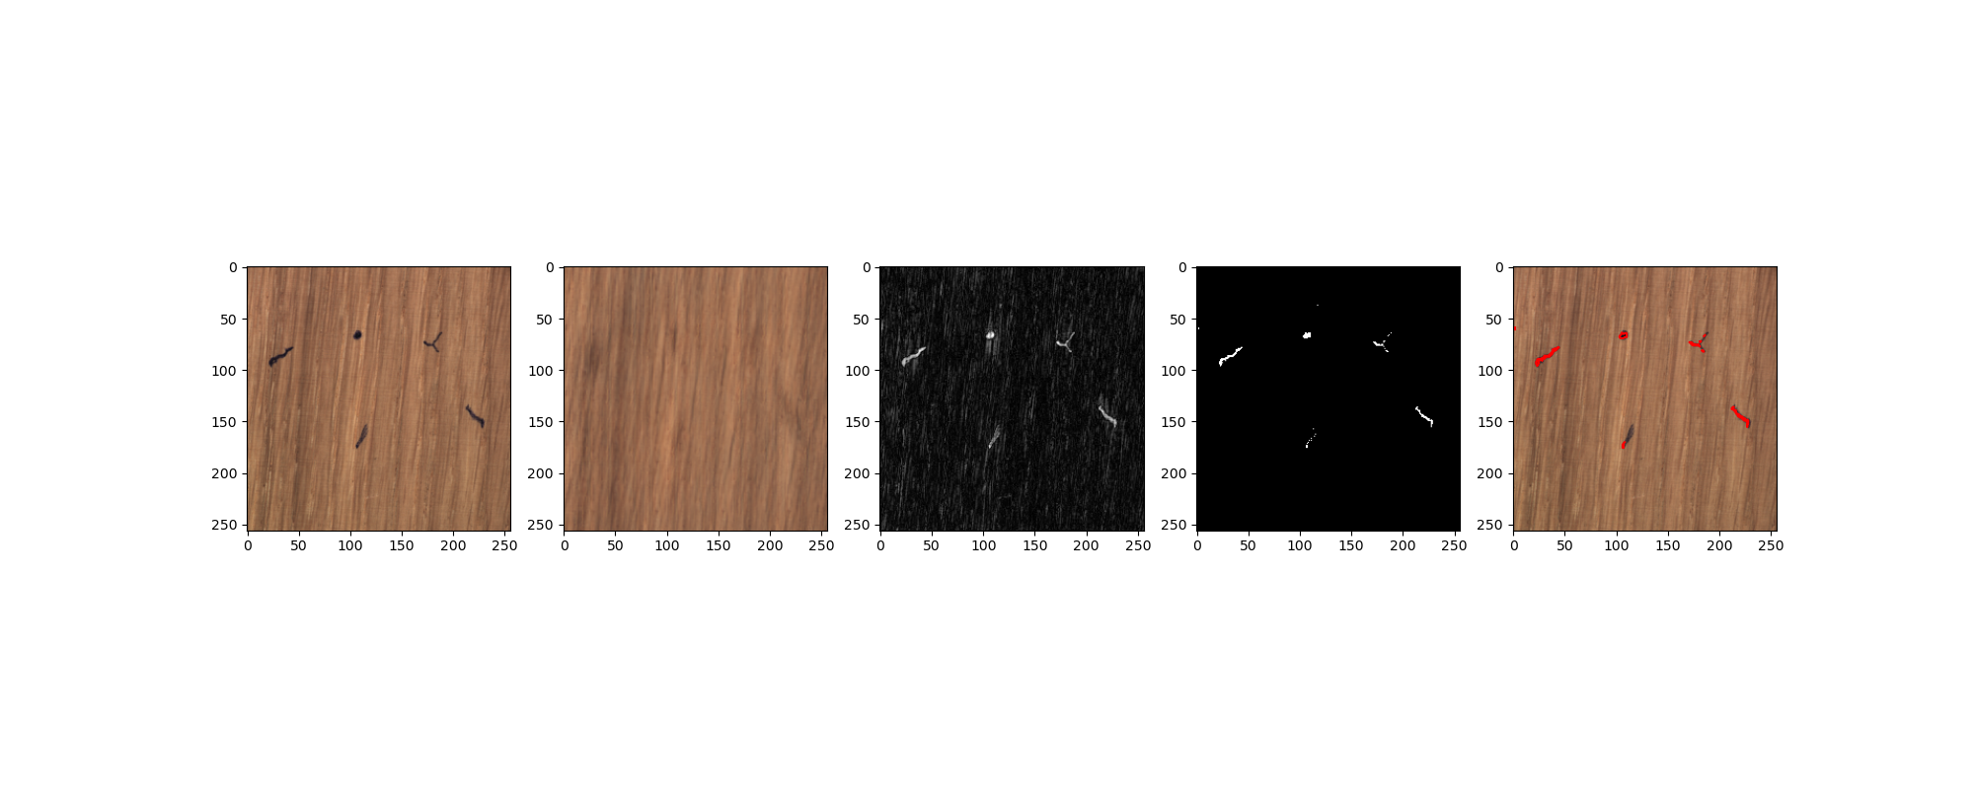
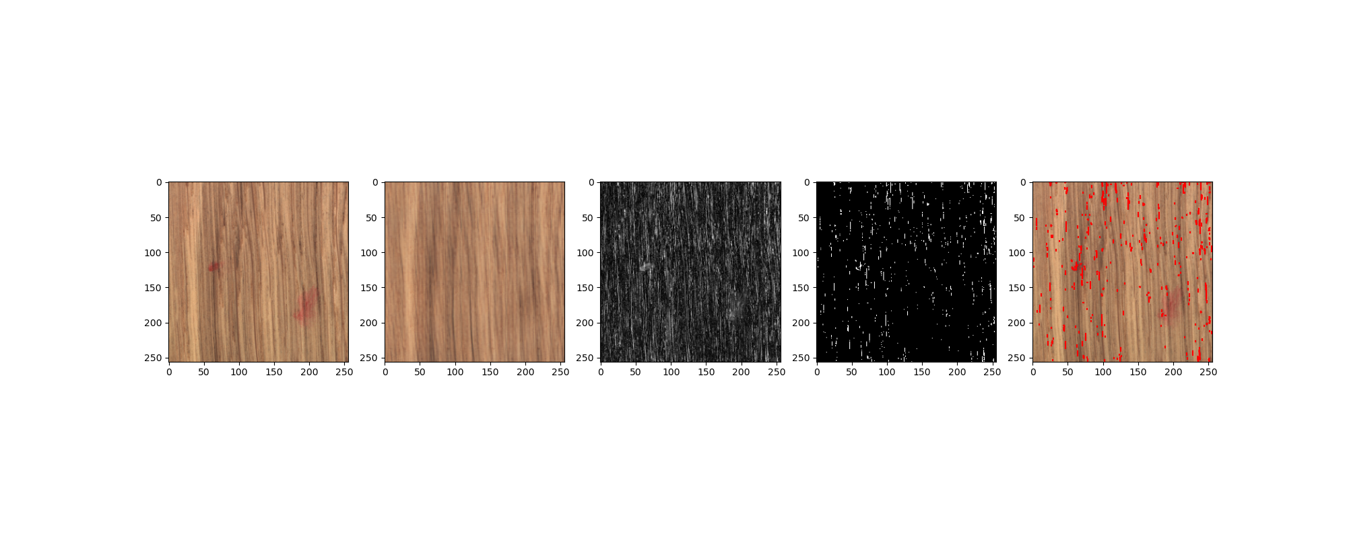
VGG
Material: Wood
Anomaly Type: Color
Model: VGG - Resnet18 Pretrained
Learning Time: 200 Cycles - 1 hour
Conclusion:
Method not suitable to note coloration errors on noisy surfaces
Identification Results by category:
- False Positives: Yes
- Missed Anomalies Yes
- Noise level on Mask Variable to High
Improvement Suggestions:
Heatmap needs to take the grain direction into account and filter for error width as to create a cleaner mask.
Input
Prediction
Heatmap
Mask
Anomalies
Color
Color

Slide 15
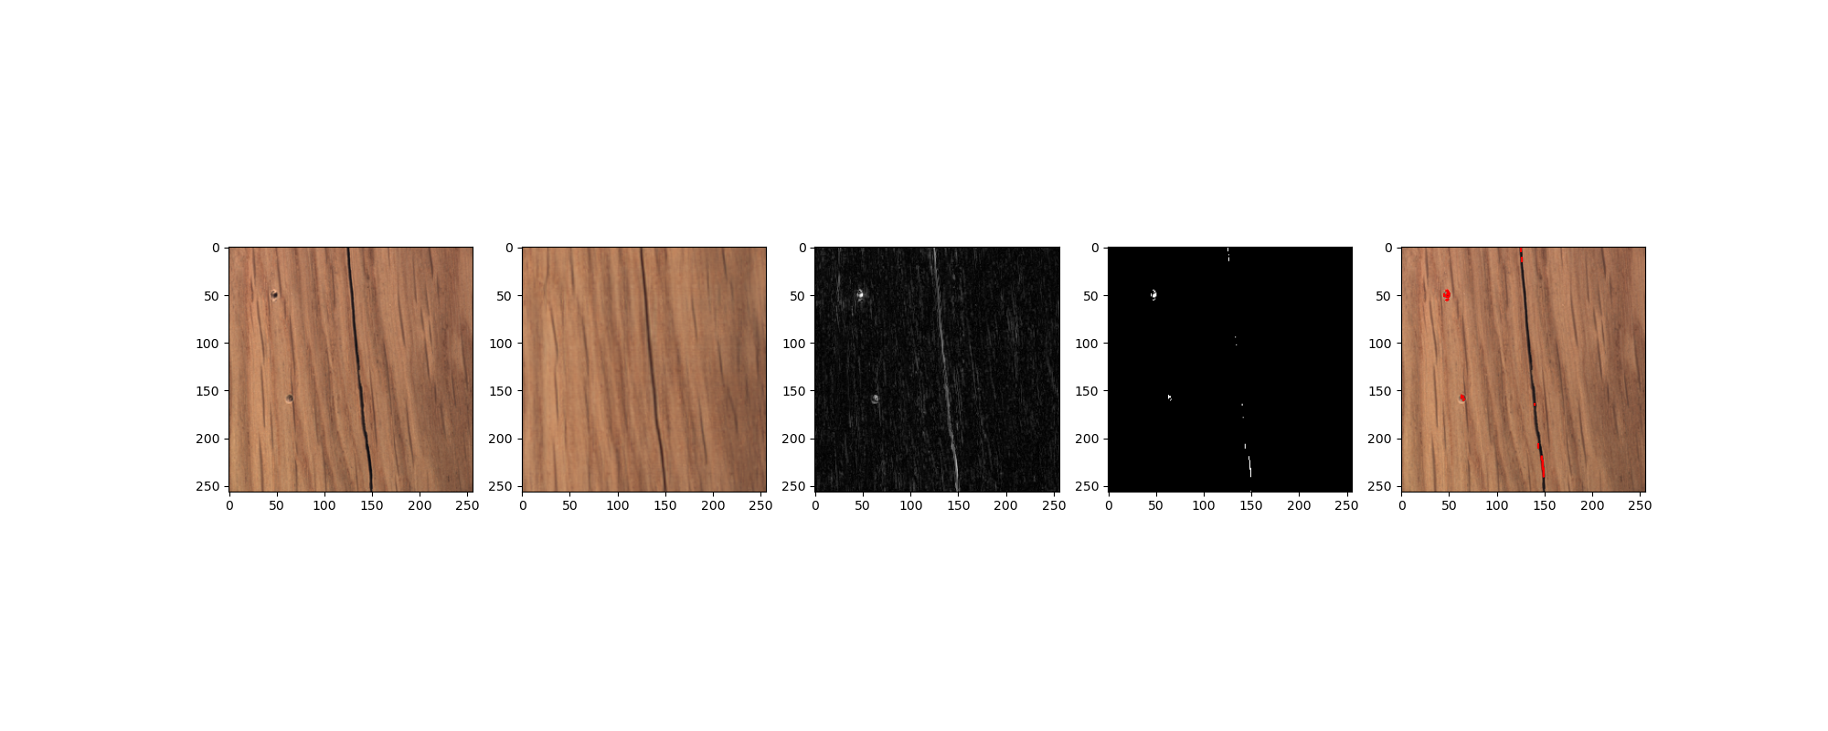
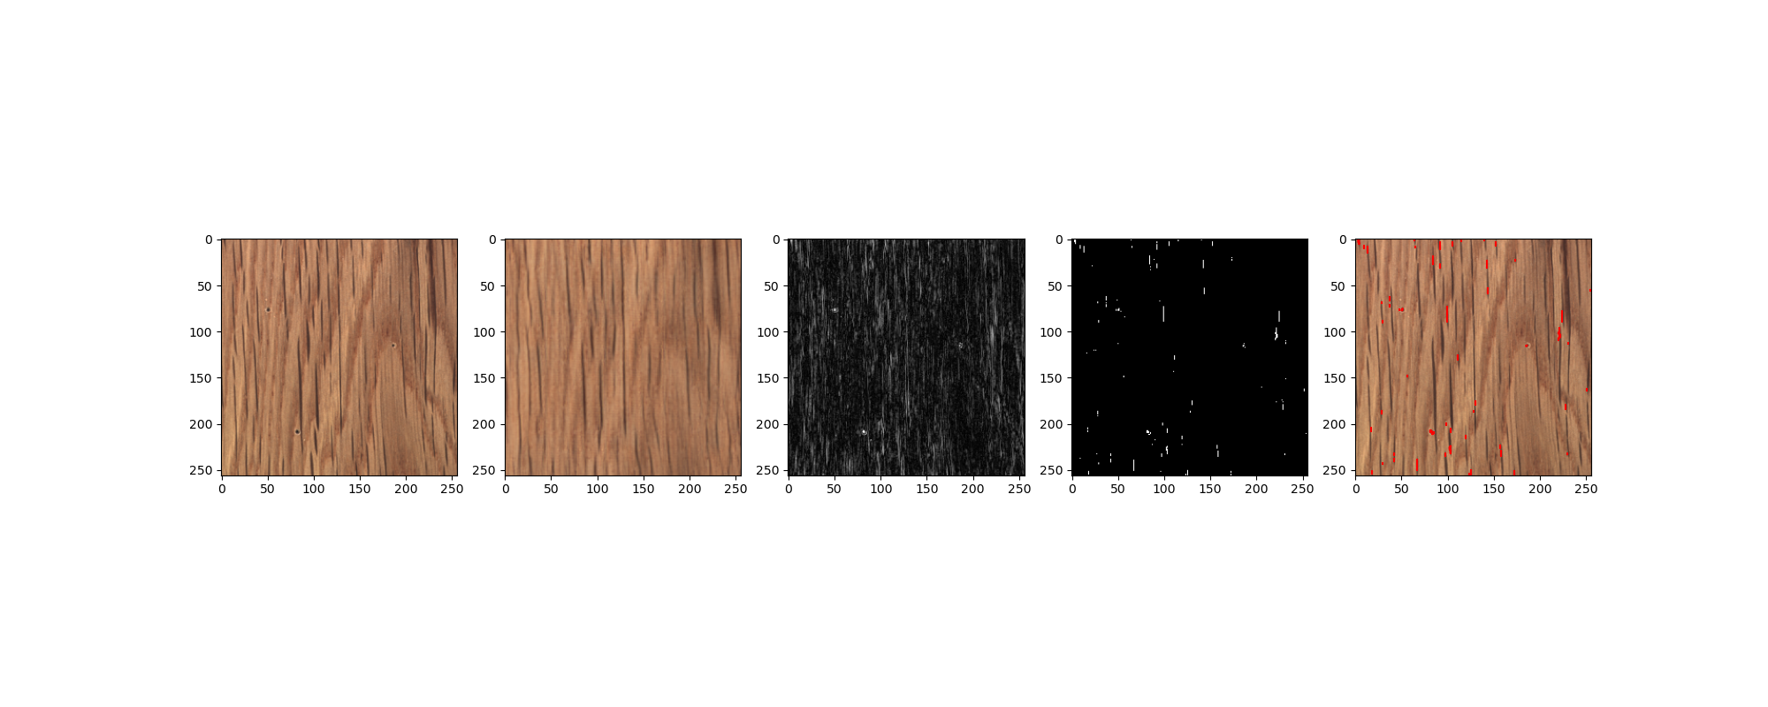
VGG
Material: Wood
Anomaly Type: Hole
Model: VGG - Resnet18 Pretrained
Learning Time: 200 Cycles - 1 hour
Conclusion:
Method suitable to note presence of holes in the wood, yet limited in guaranteeing noting all holes in cases where the size of the holes approaches the thickness of the woods features
Identification Results by category:
- False Positives: No
- Missed Anomalies Yes
- Noise level on Mask Variable to low
Improvement Suggestions:
Taking two images from different angles would make the creation of a height map possible, which would make identifying holes easier due to their relative large depth compared to other anomalies
Input
Prediction
Heatmap
Mask
Anomalies
Hole
Hole

Slide 16
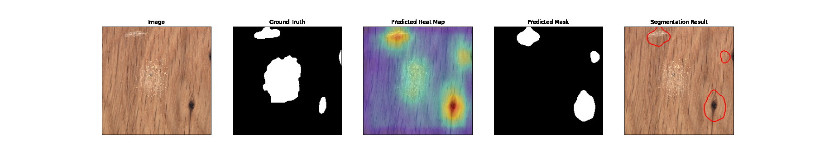
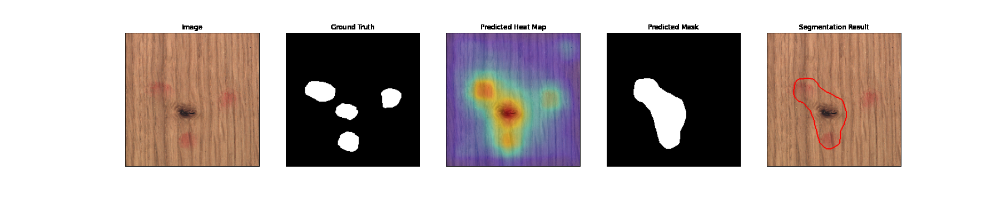
Anomalib - patchcore
Material: Wood
Anomaly Type: Combined
Model: Anomalib - Resnet50 - Pretr.
Learning Time: 10 Epochs - 2 hours
Conclusion:
Due to high different anomaly types causing different levels of response on the heatmap, combined anomalies will often only yield partial detection.
Identification Results by category:
- False Positives: No
- Missed Anomalies Yes
- Noise level on Mask Low
Improvement Suggestions:
Instead of using a singular mask via a cutoff value in the heatmap several cutoff layers should exist with cutoff values based on heatmaps from the different known anomaly types.
Input
Prediction
Heatmap
Mask
Anomalies
Combined
Combined

Slide 17
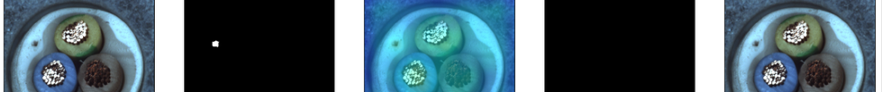
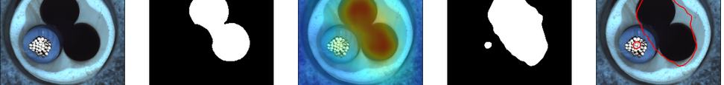
Anomalib - patchcore - Combined Materials - Cable
Material: Cable
Anomaly Type: Holes and Missing parts
Model: Anomalib - Resnet50 - Pretr.
Learning Time: 10 Epochs - 2 hours
Conclusion:
Having a number of parts with no repetition makes the detection of small defects difficult, while entire parts missing is easily noticed.
Identification Results by category:
- False Positives: No
- Missed Anomalies Yes
- Noise level on Mask Low
Improvement Suggestions:
Since the small defect was noted on the heatmap, yet not noted due to the cutoff, a cutoff mask could be used to separate the image into 3 parts based on color. Enabling more selective choice of heatmaps cutt off points.
Input
Ground truth
Heatmap
Mask
Anomalies
Holes
Missing

Slide 18
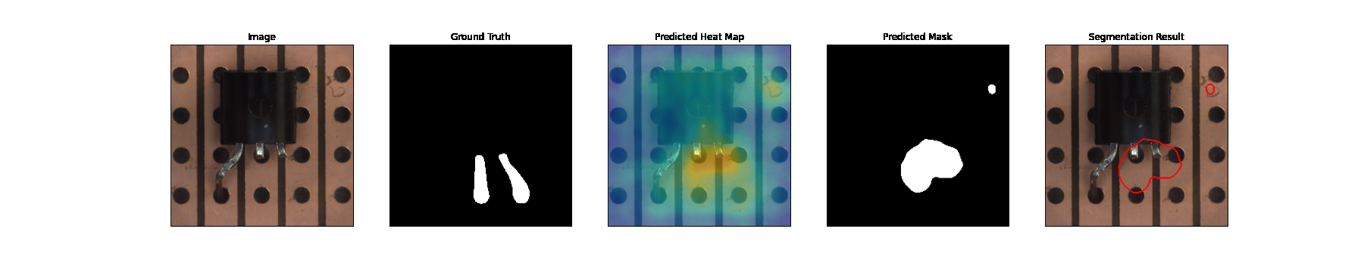
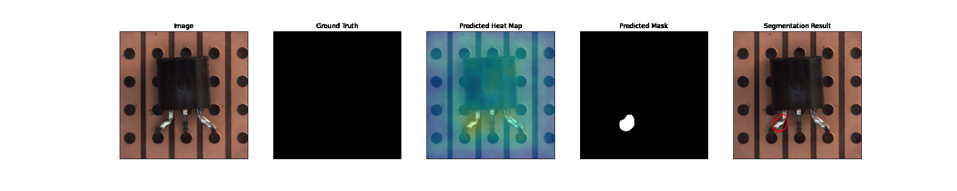
Anomalib - patchcore - Combined Materials - Transistor
Material: Transistor
Anomaly Type: Missing parts and None
Model: Anomalib - Resnet50 - Pretr.
Learning Time: 10 Epochs - 2 hours
Conclusion:
Due to the differences caused by the illumination of reflective parts small changes in how the metal part was bent can cause false positives.
Identification Results by category:
- False Positives: Yes
- Missed Anomalies No
- Noise level on Mask Low
Improvement Suggestions:
Adding more diffuse light sources to reduce the amount of created shadows
Input
Ground truth
Heatmap
Mask
Anomalies
Missing
False Positive

Slide 19
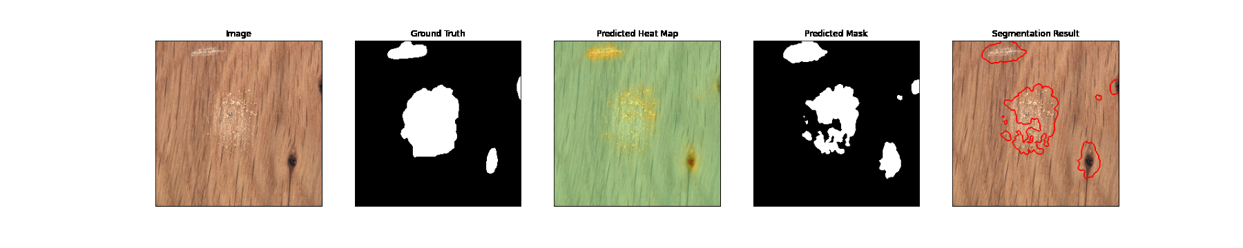
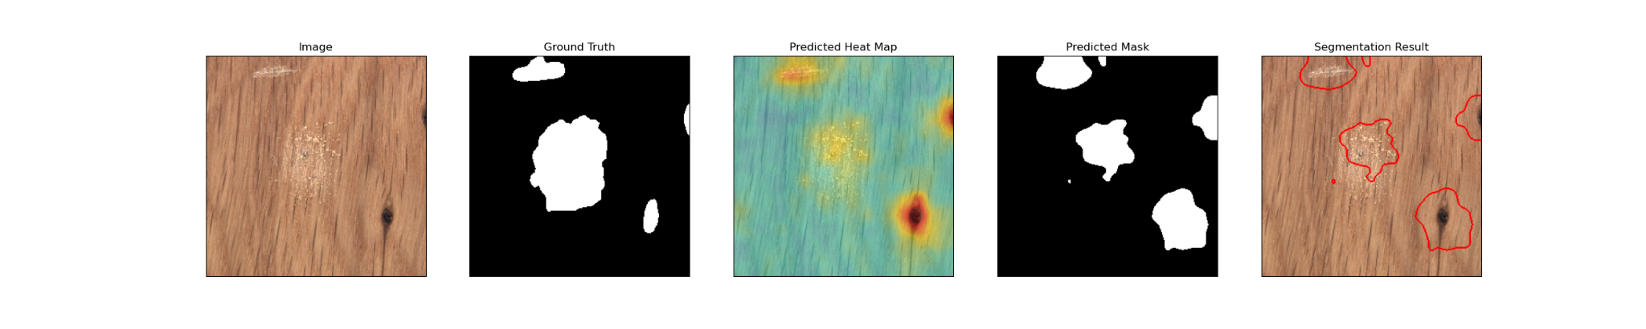
Anomalib - Patchcore vs Stfpm vs Padim
Material: Wood
Anomaly Type: Combined
Model: Anomalib - Resnet50 - Pretr.
Learning Time: 10 Epochs - 2 hours
Input
Ground truth
Heatmap
Mask
Anomalies
Patchcore
Stfpm
Padim

Slide 20
Conclusion
Deep learning can be helpful to detect anomalies on a production line.
Advantages of using deep learning over human quality control:
works as long as electricity is present
low error rate, depending on the algorithm
low maintaining costs
accuracy can be improved even further, up to a superhuman point
fast and scalable
Disadvantages:
limited to visual anomalies
high development and deployment cost
for the best results, neural net needs to be trained on a custom dataset
to increase accuracy, you might need a large dataset

Slide 21
Thank you for listening, any questions?

Slide 22
Sources
Autoencoder. (n.d.). Retrieved September 23, 2022, from https://de.mathworks.com/discovery/autoencoder.html
Bergmann, P., Batzner, K., Fauser, M., Sattlegger, D., & Steger, C. (2021). The MVTec Anomaly Detection Dataset: A Comprehensive Real-World Dataset for Unsupervised Anomaly Detection. International Journal of Computer Vision, 129(4), 1038–1059. https://doi.org/10.1007/s11263-020-01400-4
Comp Three Inc. | Experienced Data And AI Consultants. (n.d.). Retrieved September 23, 2022, from https://www.compthree.com/
Deep Learning. (2022). In Wikipedia. https://de.wikipedia.org/w/index.php?title=Deep_Learning&oldid=226190292
Using Deep Learning Models / Convolutional Neural Networks. (n.d.). Retrieved September 23, 2022, from https://docs.ecognition.com/v10.0.2/eCognition_documentation/User%20Guide%20Developer/8%20Classification%20-%20Deep%20Learning.htm
Zeiler, M. D., & Fergus, R. (2013). Visualizing and Understanding Convolutional Networks (arXiv:1311.2901). arXiv. http://arxiv.org/abs/1311.2901

